Slide 1
Candidate Task
Ipek Baris and Korok Sengupta
31.10.2019

Slide 2
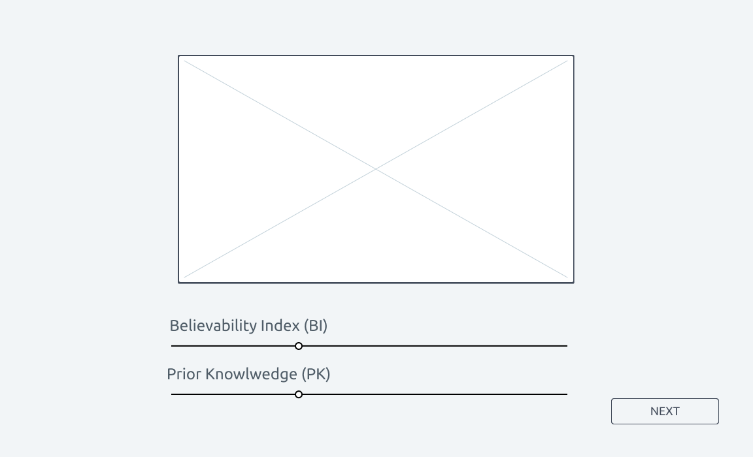
Task
Read from a given json file
Generate a web interface from the given json file
{
"url": "https://www.altnews.in/no-this-is-not-pm-modis-mother-hiraben-dancing/",
"source": "google_factcheck_explorer",
"claim": "PM Modi's mother dancing",
"claim_url": "https://www.facebook.com/watch/?v=2626365854076699,
https://www.facebook.com/prakashpatel.prakashpatel.739/videos/2403091746677920/,
https://twitter.com/thekiranbedi/status/921229403249508353",
"label": "fake",
"date": "2019-10-07T00:00:00",
"author": "Alt News"
}
https://de.wikipedia.org/wiki/
Datei:Stephen_Hawking_050506.jpg
Notes:
url : fact checked article
claim_url: the problematic urls/articles
lable: the status given by the author

Slide 3
Task
Create a backend that collects the following information
Source url (you will get this from the json file)
Source Name (if the tweet is from Trump, then Trump)
Prior Knowledge (given by the user)
Believability Index (given by the user)
Parts of the “post”
Headline
Body
Original Decision (Fake or Not fake : available from json)
Published Date
The backend must get populated continuously
https://de.wikipedia.org/wiki/
Datei:Stephen_Hawking_050506.jpg

Slide 4
Deadline
In order to be evaluated : Please send in your repository links by November 10, 2019.
On November 11, 2019, from 4:30 pm onwards, we will have a small session
of 5 minutes per participant to know what have you done and how do you
plan to take it forward.
It's only after that we will make our decision on the final candidate.
https://de.wikipedia.org/wiki/
Datei:Stephen_Hawking_050506.jpg

Slide 5
Thank You

